Slide 1


Probability and Statistics Project: Customer Behavior Analysis

Slide 2

Introduction
1
Customer Behavior Analysis
Customer behavior analysis is the process of studying and understanding the actions and decisions of customers in order to improve business strategies and marketing efforts.

Slide 3

Exploratory Data Analysis
Exploratory Data Analysis (EDA) is a crucial step in the data analysis process. It involves summarizing the main characteristics of a dataset, often with the help of statistical graphics and other data visualization methods. The goal of EDA is to understand the underlying patterns, relationships, and trends in the data before applying more advanced statistical or machine learning techniques.

Slide 4

Methodology
Data Overview
Cleaning and Transformation
Statistical Analysis
Outlier Detection
Categorical Variable Analysis
Churn Analysis

Slide 6

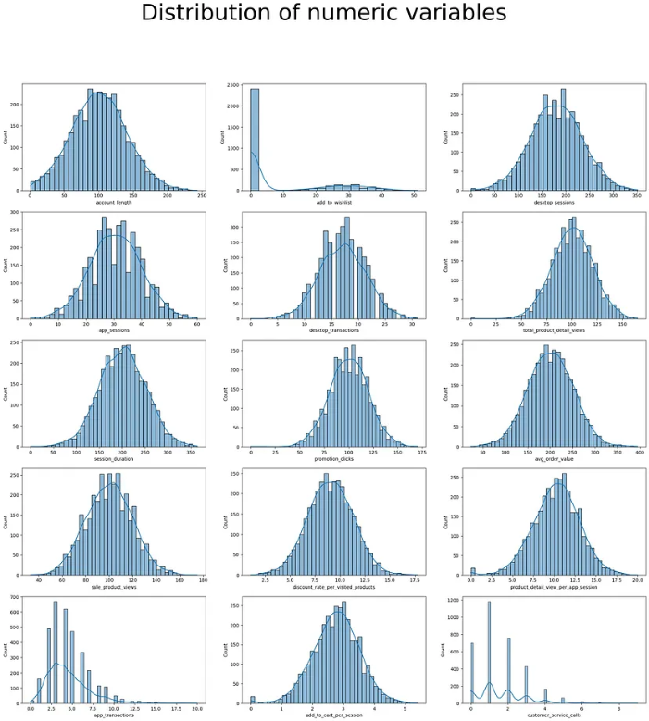
Results and Findings

Slide 7
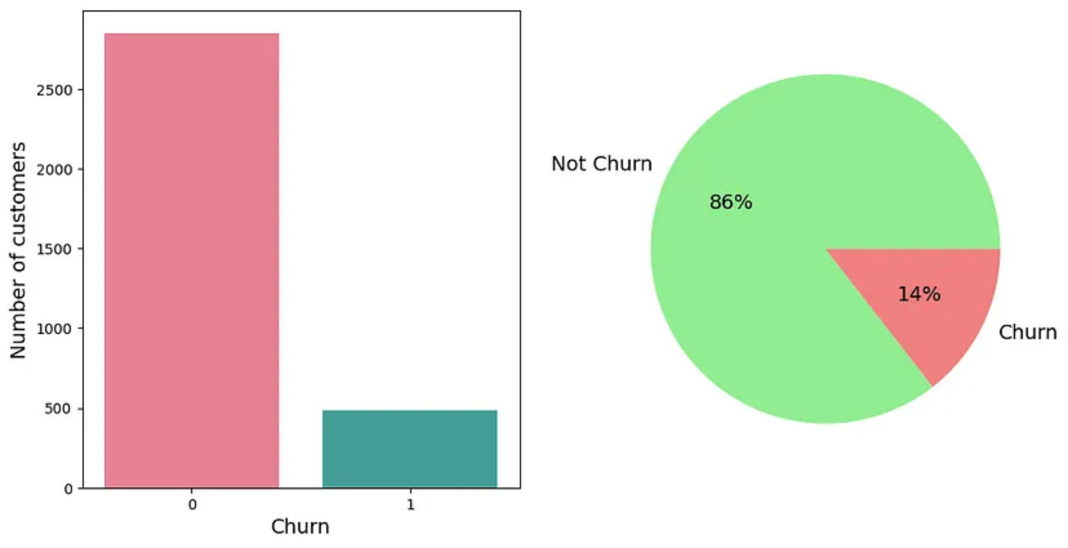

Slide 8
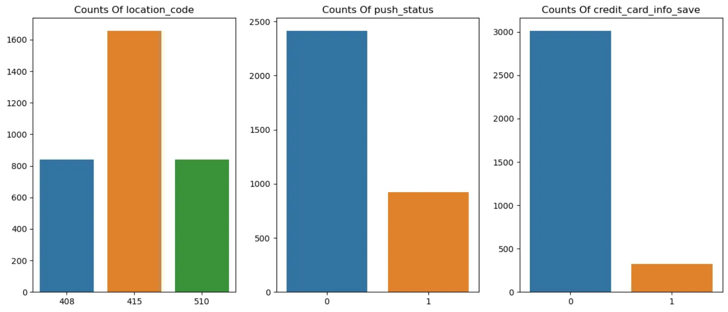

Slide 9
Findings from graph
We can see that:
Majority of customers are located in 415.
Majority of customers don’t allow push notifications
Majority of customers don’t save the credit card information on the side

Slide 10
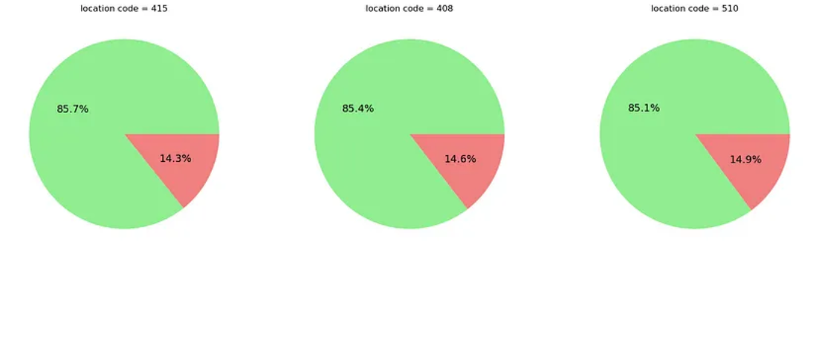

Slide 11
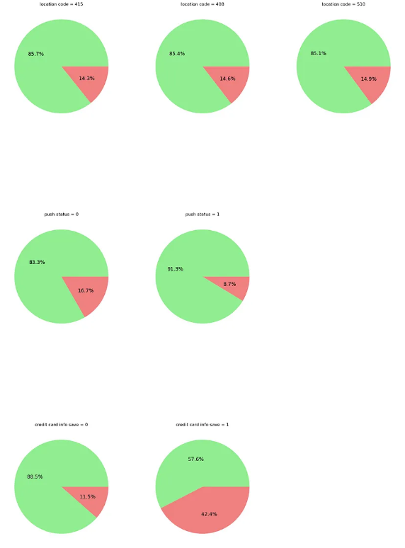

Slide 12
Findings
Location code doesn’t seem to be a strong predictor of churn, as the percentage of customers who churn is similar across different locations.
Customers with push notifications enabled are less likely to churn, suggesting that encouraging customers to activate push notifications may help reduce churn.
The presence of saved credit card information on the site appears to be a strong indicator of a customer’s likelihood to remain with the business. Customers who have saved their credit card information on the site are much less likely to churn than those who haven’t. This correlation makes sense, as saving credit card information on the site demonstrates trust in the brand, which is likely to lead to greater customer loyalty.

Slide 13

Conclusion
In conclusion, using Python for customer behavior analysis can provide valuable insights for businesses. By loading the customer behavior data into a Pandas DataFrame, and conducting Exploratory Data Analysis, businesses can understand their customer demographics, purchase history, and other relevant information. This project helped us uncover insights from descriptive statistics of data such as the average account length, wish list adds, desktop and app sessions, session duration, promotion clicks, and sales product views. By identifying outliers and relationships between features, businesses can improve their strategies and marketing efforts to better serve their customers.

